Slide 1

Automation Testing Project nopCommerce
Prepared By: Rampalli Charan Version: 1.0

Slide 2
Introduction
This project automates the functional testing of the nopCommerce website. It covers key modules efficiently.
Technologies used: Selenium WebDriver, TestNG, Cucumber, Java, Excel integration (Apache POI).
Automation ensures accuracy, reduces manual effort, and validates end-to-end user workflows efficiently.

Slide 3
Tools & Technologies
Programming Language: Java
Testing Framework: TestNG, Cucumber
Automation Tool: Selenium WebDriver
Data Management: Excel Integration (Apache POI)
Reporting: TestNG Reports & Extent Reports, Custom Listener
IDE: Eclipse
Build Tool: Maven

Slide 4
Test Scenarios
User Registration
Login with valid, invalid, and empty credentials
Verify nopCommerce
Cell selection and validation
Add to Cart functionality
Shopping Cart verification
Checkout process with billing address validation

Slide 5
Test Flow
Launch Browser → verify homepage title & logo.
Register User Successfully → validate account creation.
Login User Successfully → valid, invalid, empty credentials & “My Account” check.
Add Product to Cart → select product, add to cart, increase quantity.
Open Shipping Page & Enter Shipping Address → fill billing/shipping info.
Proceed to Checkout → review order, select payment, confirm.
Navigate Other Modules → Digital Downloads, Books.
Screenshots & Logs → captured for critical steps and failures.
Workflow ensures end-to-end functional validation with sequential execution.

Slide 6
Excel Integration
Test data such as registration details, login credentials, and checkout info is stored in Excel sheets.
Apache POI library is used for reading and writing data.
Supports data-driven testing, reduces hardcoding, and allows reusable test cases.

Slide 7
Reporting
TestNG default reports generated after execution.
Custom Listener (ITestListener) implemented for enhanced logging.
Screenshots captured for failed test cases.
Extent Reports used for well-structured, step-wise execution results.

Slide 8
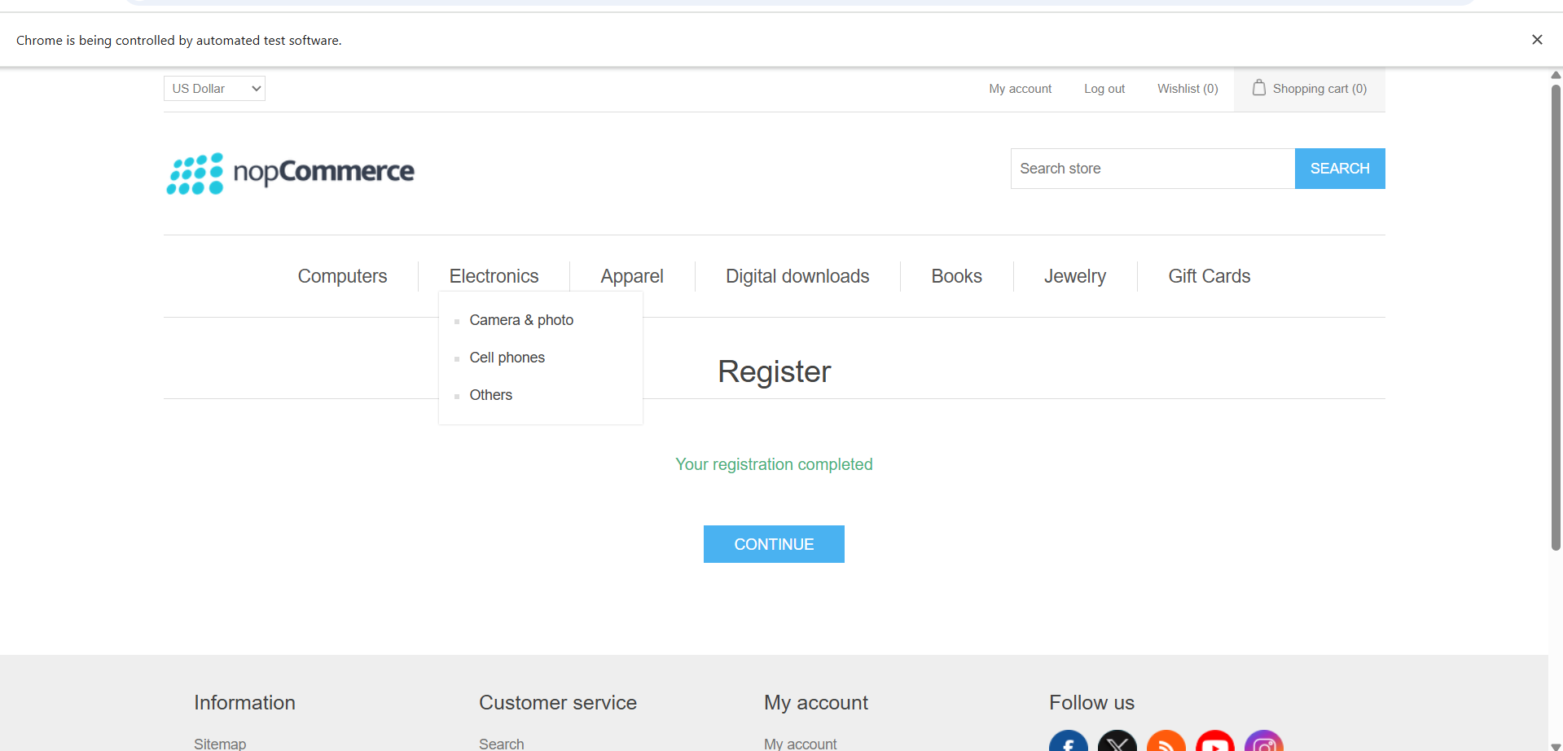
Screenshots
Screenshot of Registration Test

Slide 9
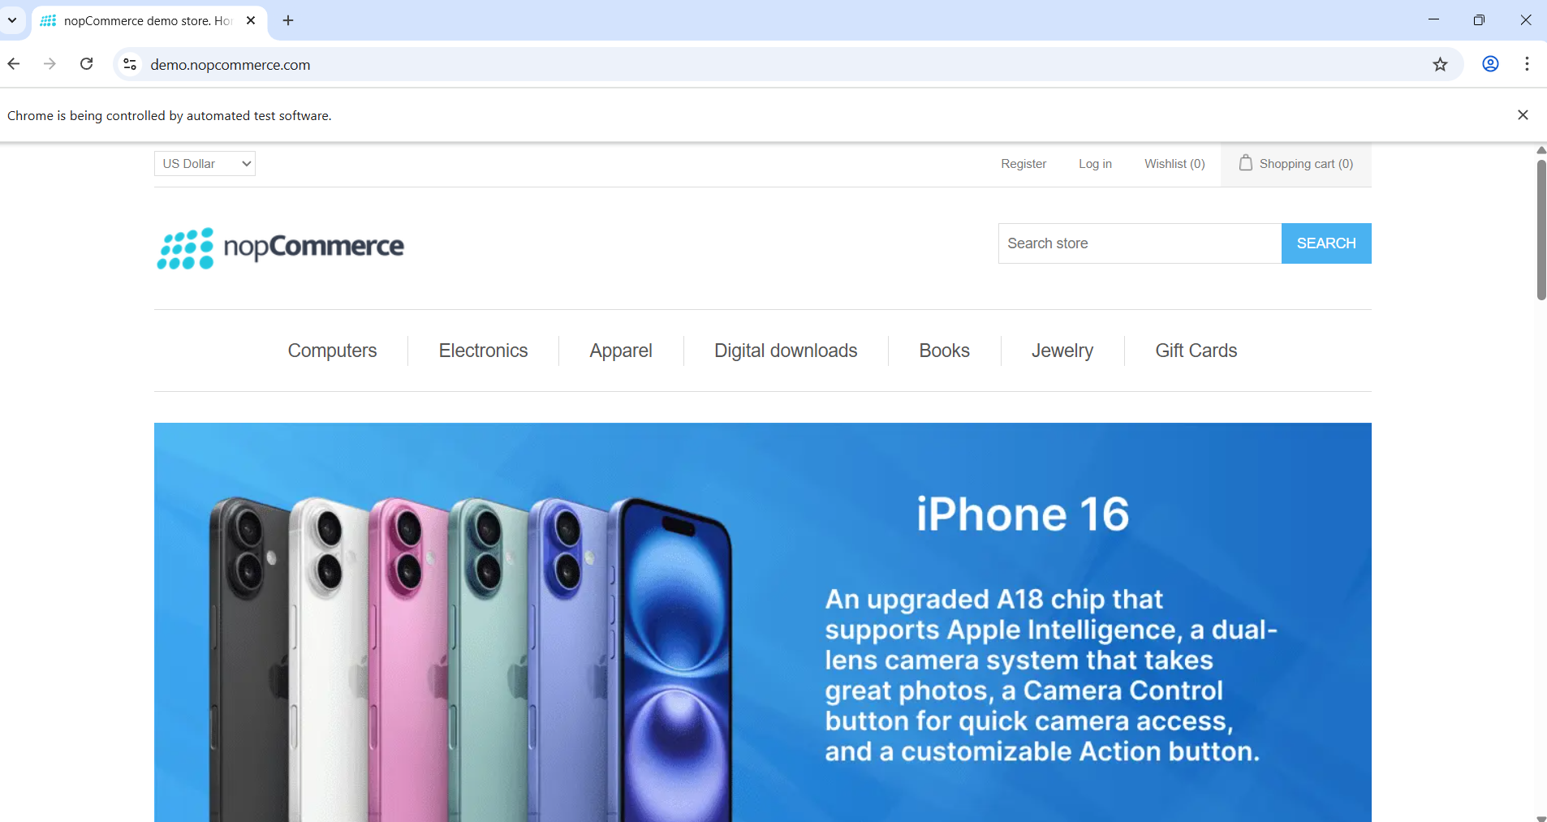
Screenshot of Login Test

Slide 10
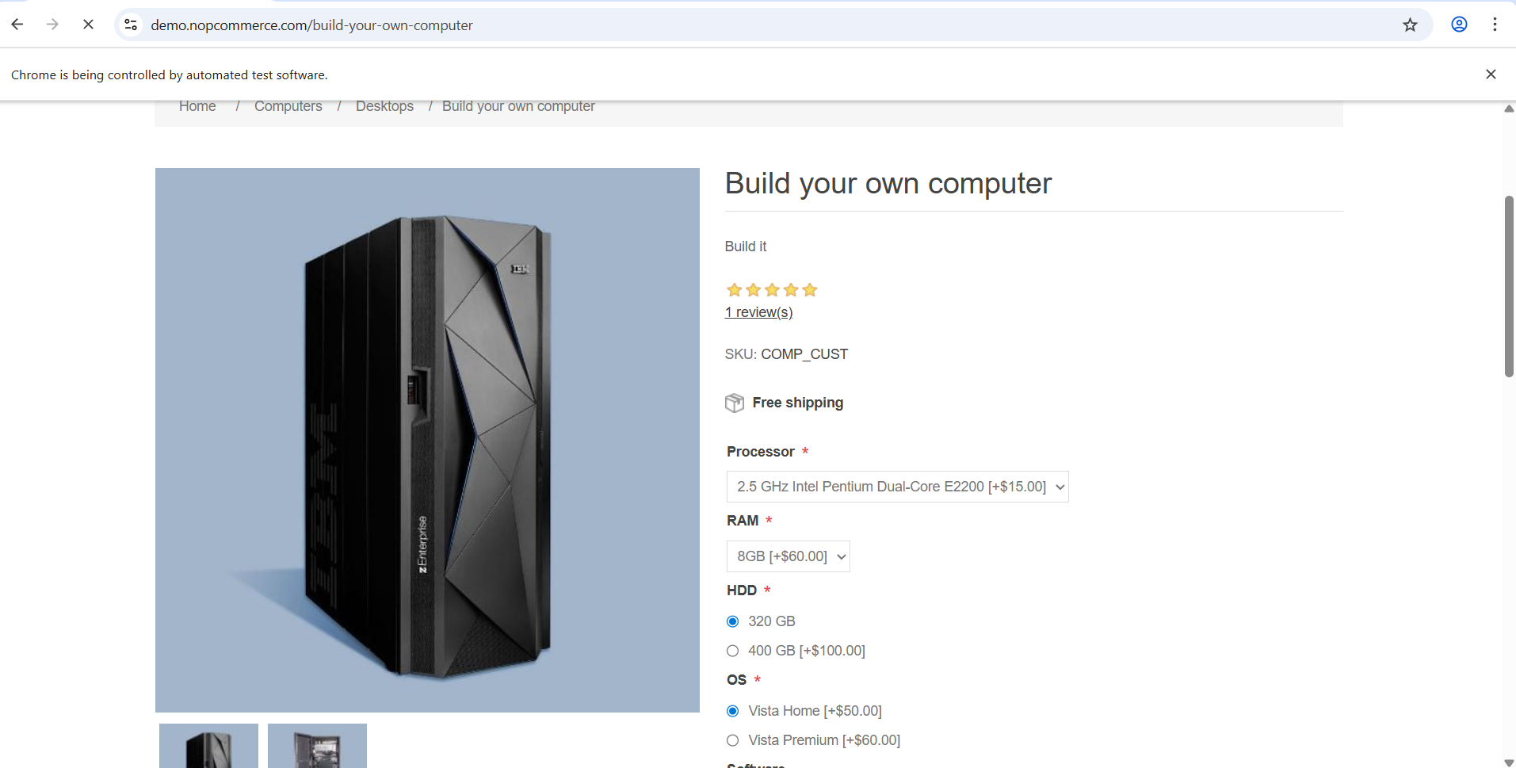
Screenshot of Selecting Product

Slide 11
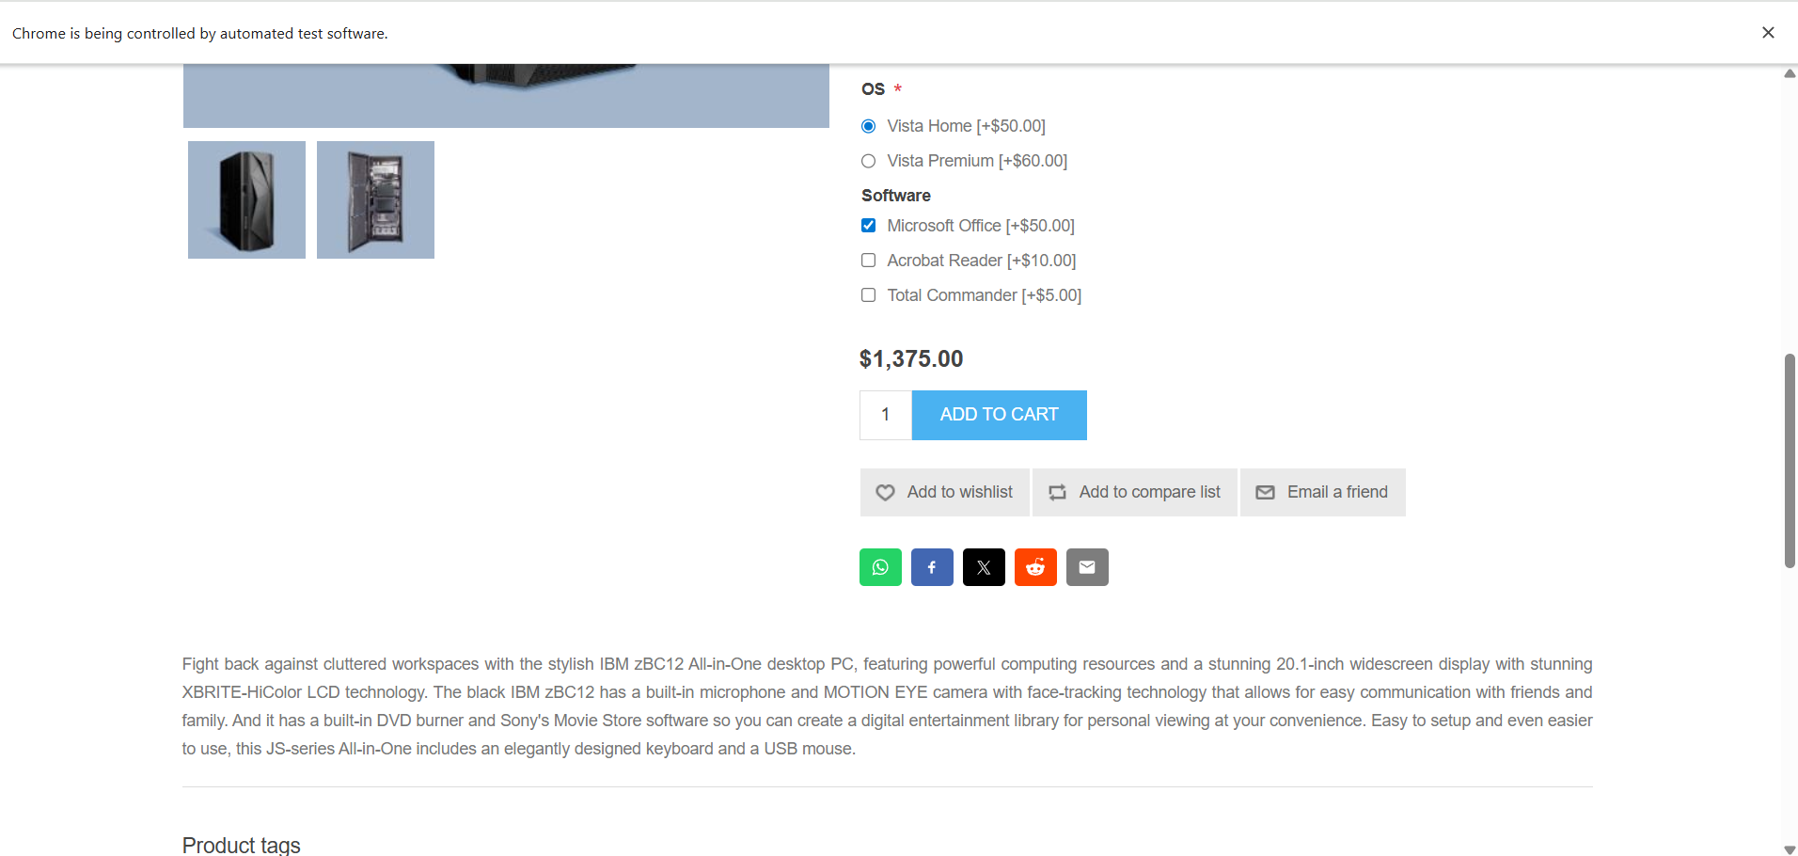
Screenshot of Add to Cart Process

Slide 12
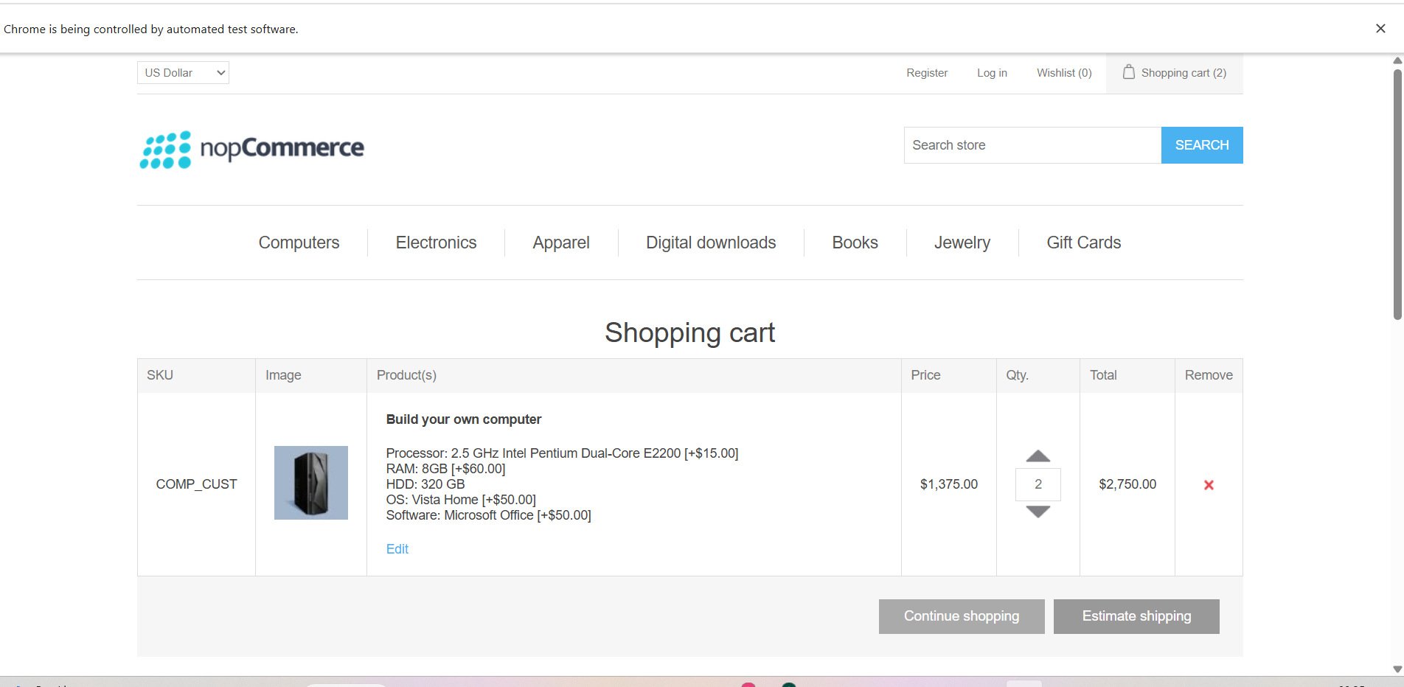
Screenshot of Shipping Process

Slide 13
Conclusion
Automated key functionalities of the nopCommerce website.
Increased test coverage and reliability.
Reduced manual testing effort.
Framework supports future module extension.
Demonstrates integration of Selenium, TestNG, Cucumber, and Excel in a real-world scenario.

